Slide 1
Beautiful Patterns
Day 3

Slide 2

New Teams!
Not a surprise anymore
Every day, we’re shuffling

Slide 3

Grid Game
Let’s draw a grid
I leave the room!
Change 1 box
Now I guess which box is new!

Slide 4
Now you try it
Can you do the same thing?
What pattern can you use to guess the box right every time?

Slide 5
Guess the numbers
In your groups, have one person think of a number from 1-100. Take turns trying to guess the number
Notes:
Need cards with numbers 1-15
Give to 15 students randomly

Slide 6
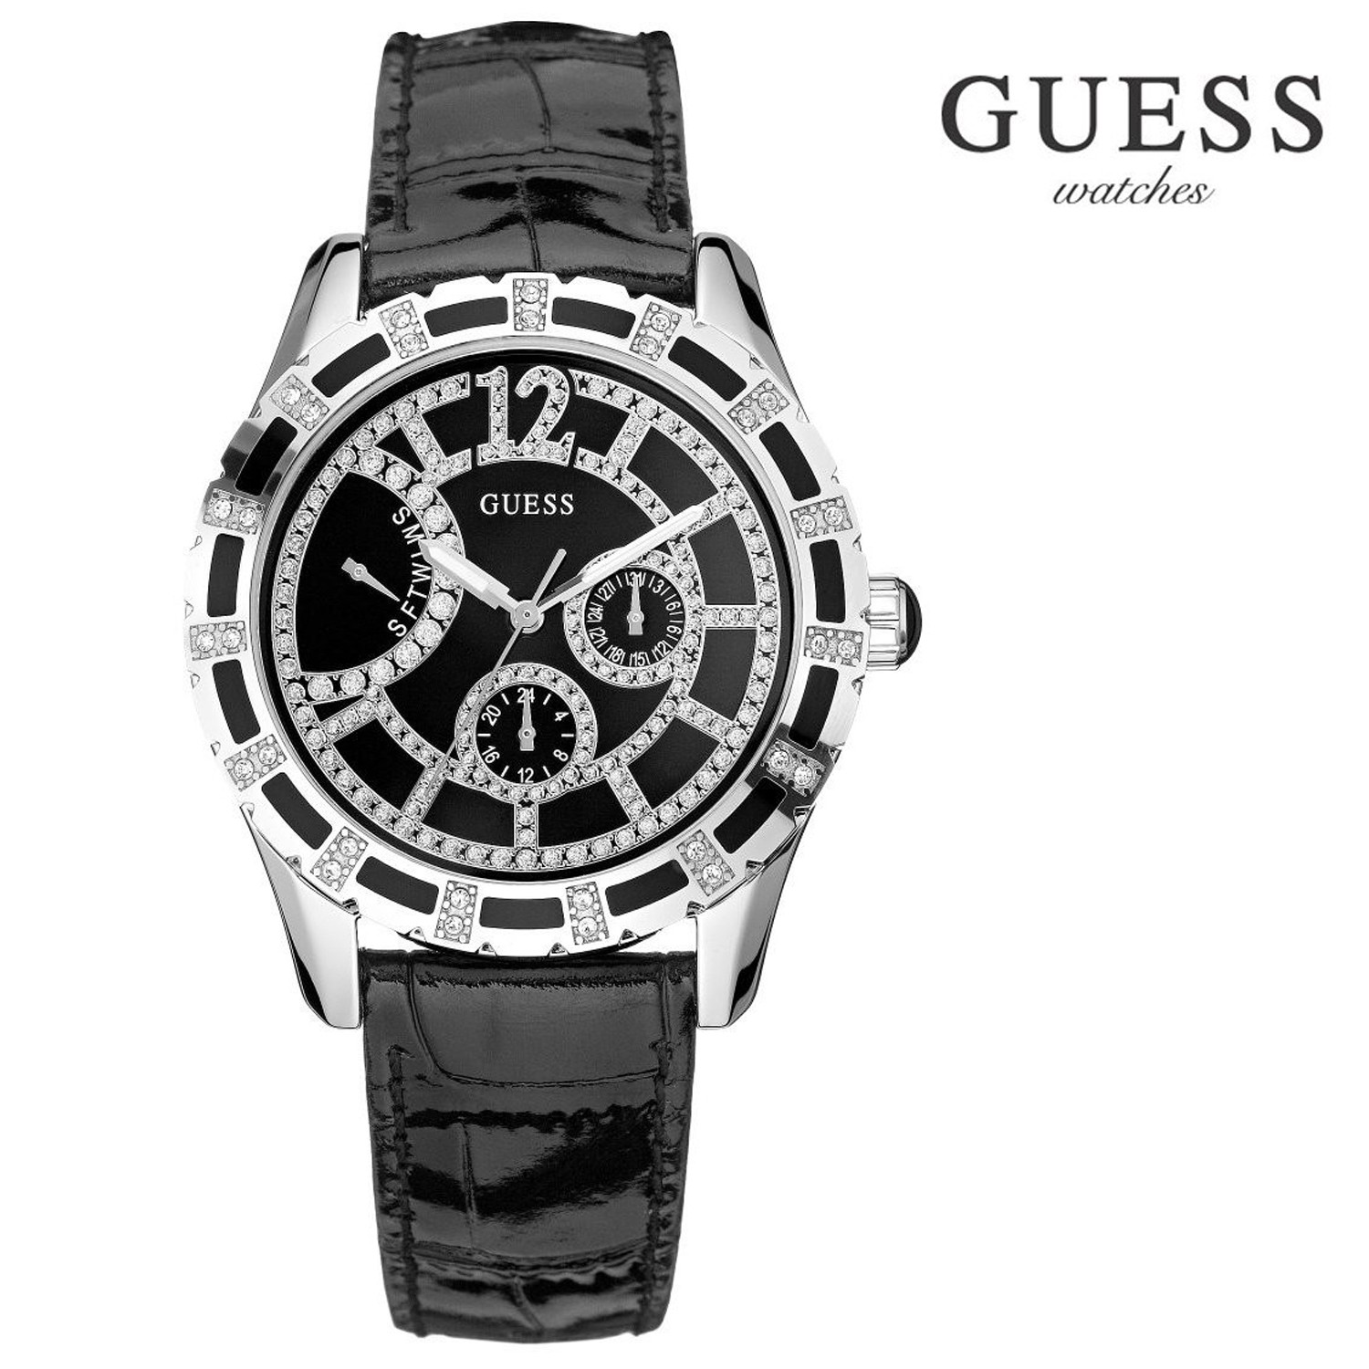
Guess the numbers
Now, try this activity again, but this time, each time you guess, they get to know whether the number is lower or higher.
Notes:
Need cards with numbers 1-15
Give to 15 students randomly

Slide 7
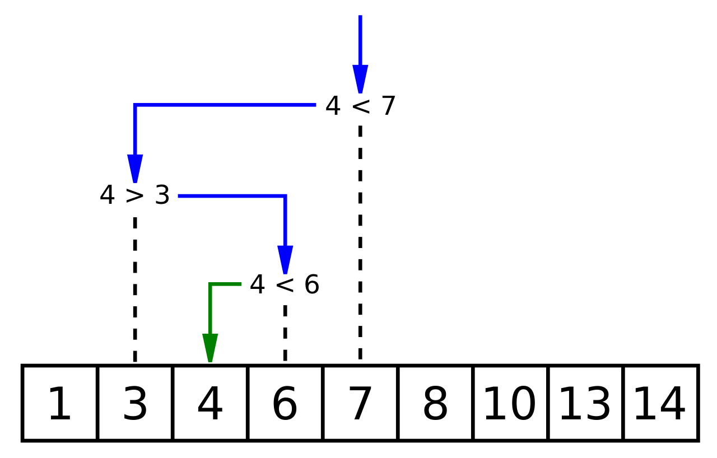
Pattern
Is there a pattern that helps us guess the answer as fast as possible?
This Photo by Unknown Author is licensed under CC BY-SA

Slide 8
Maximum number of guesses
What’s the maximum number of guesses you would need to guess a number 1-100?
1-1000?
1-1000000?
Etc…..

Slide 9


Slide 10
Cipher / Hash Function
A
B
C
D
E
F
G
H
I
1
2
3
4
5
6
7
8
9
J
K
L
M
N
O
P
Q
R
10
11
12
13
14
15
16
17
18
S
T
U
V
W
X
Y
Z
19
20
21
22
23
24
25
26

Slide 11
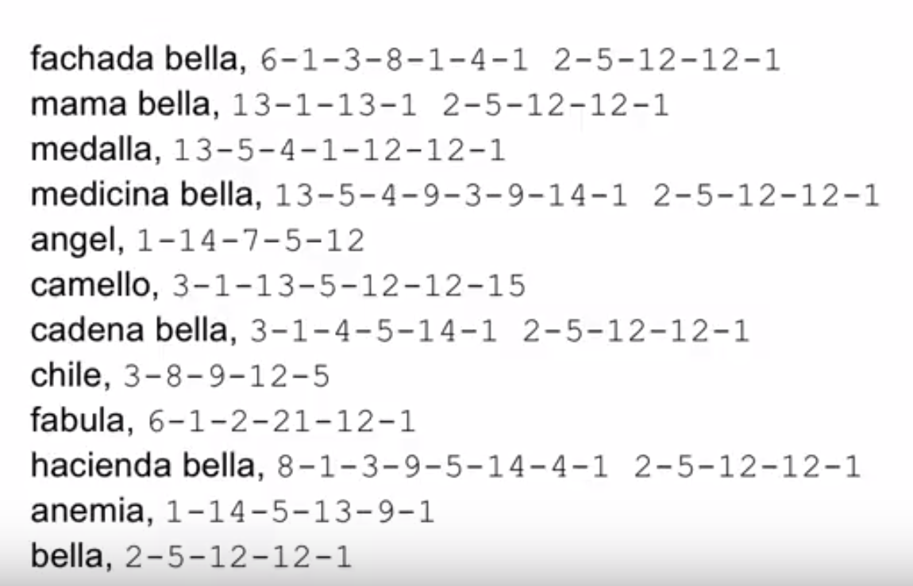

Slide 12
What number is your name?
Nomi Vilvovsky -> 14+15+13+9 22+9+12+22+15+22+19+11+25 => 51+157=208

Slide 13
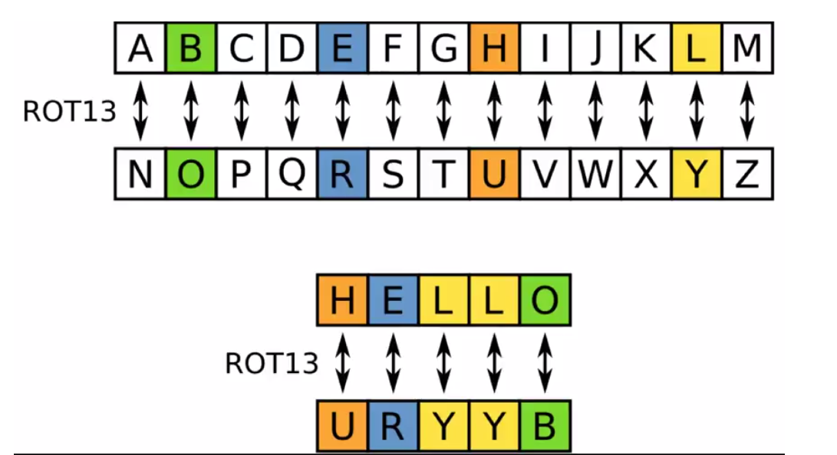
Ciphers are {secret} codes

Slide 14
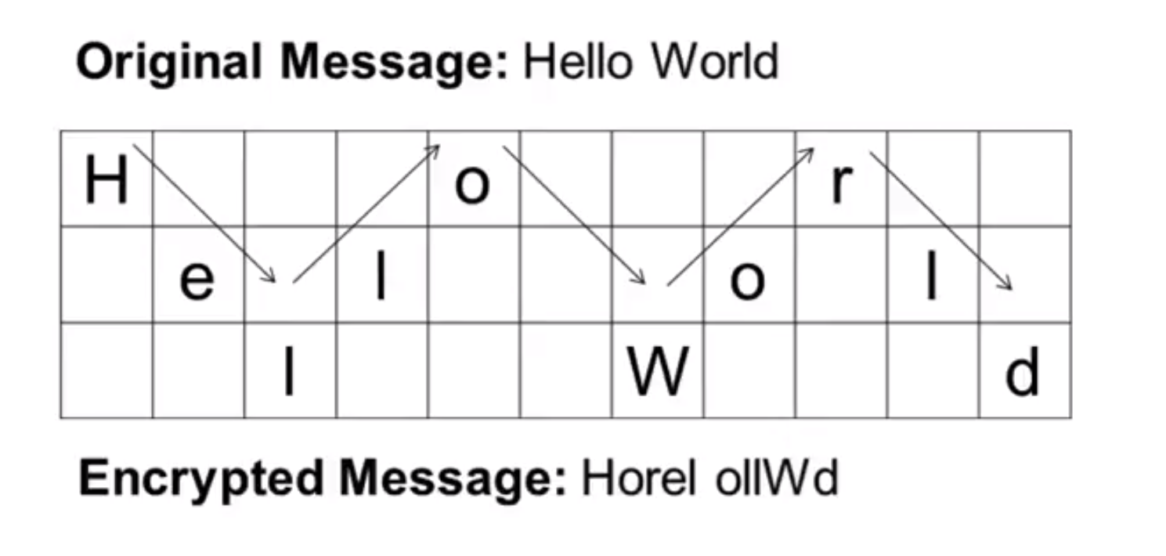
Rail fence cipher

Slide 15
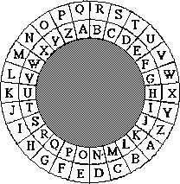
Cipher Wheel
You can use a cipher key
Move the wheel for every message

Slide 16

Create A code
Create your own cipher in your groups
Use patterns!

Slide 17

Send a message using your cipher
Send a message to another group using your cipher
See if you can decode the messages you get!
This Photo by Unknown Author is licensed under CC BY

Slide 18
Logic symbols
X ^ Y = X and Y
X v Y = X or Y (X, Y, or X ^ Y)
X ⊕ Y = X xor Y (X or Y, NOT X ^ Y)
~X = Not X

Slide 19
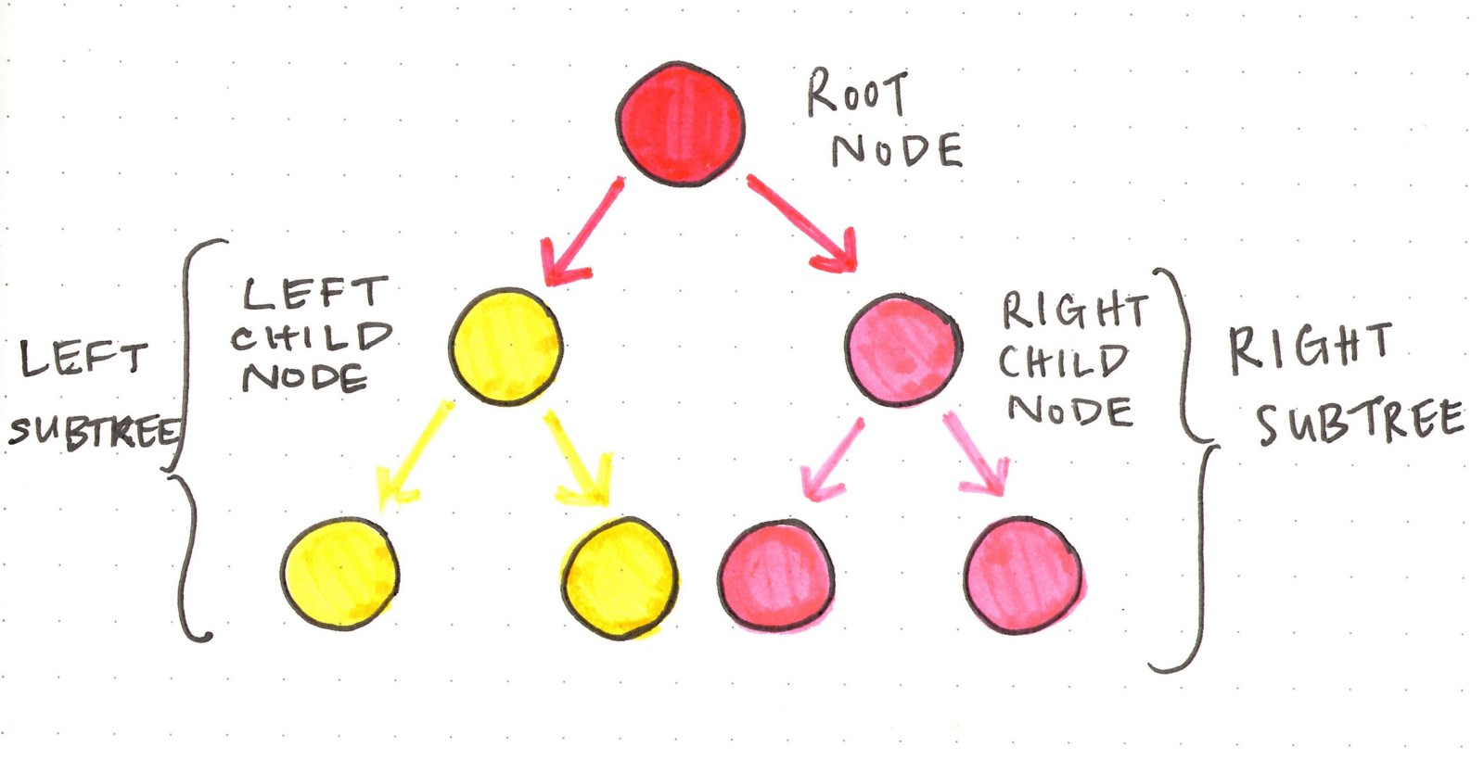
Tree

Slide 20
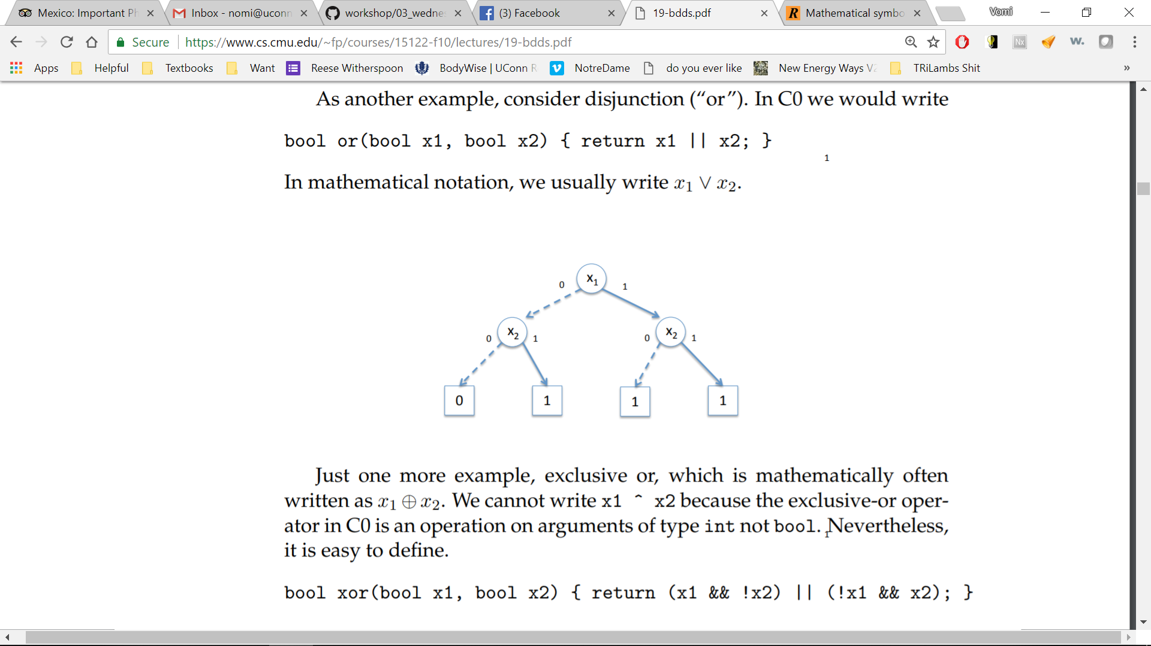
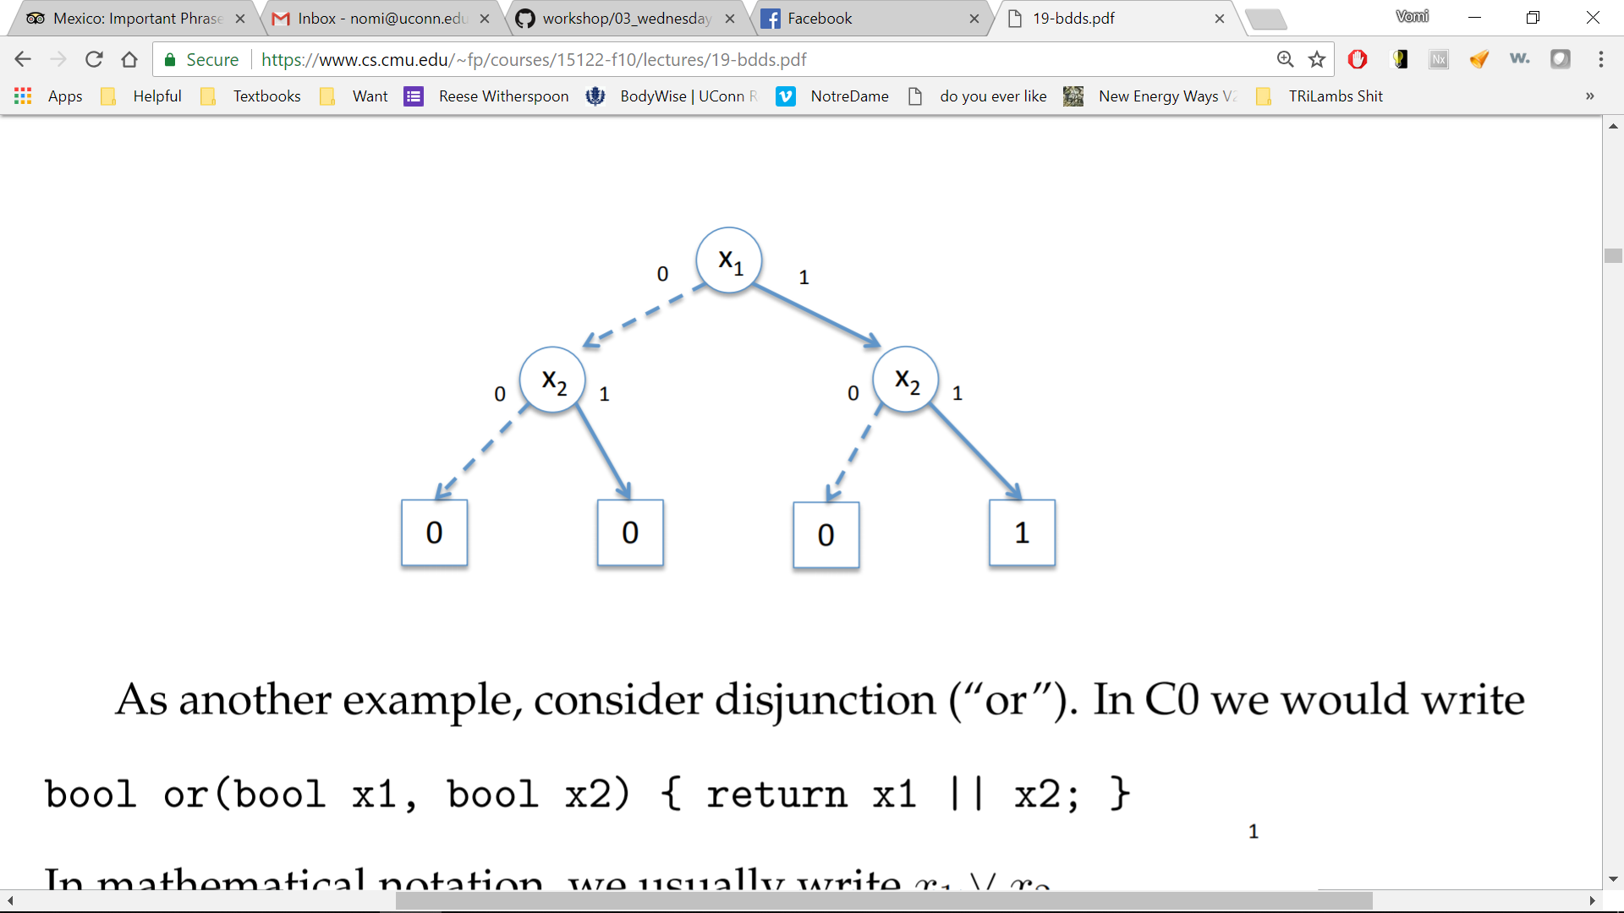
Binary Tree
X1 or X2= X1 v X2
X1 and X2= X1 ^ X2

Slide 21
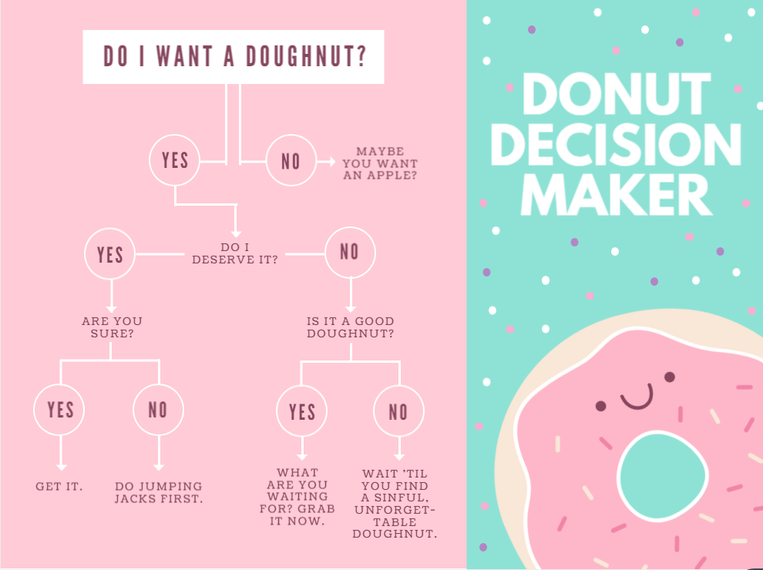
Binary Decision Tree

Slide 22
Break
Lunch

Slide 23
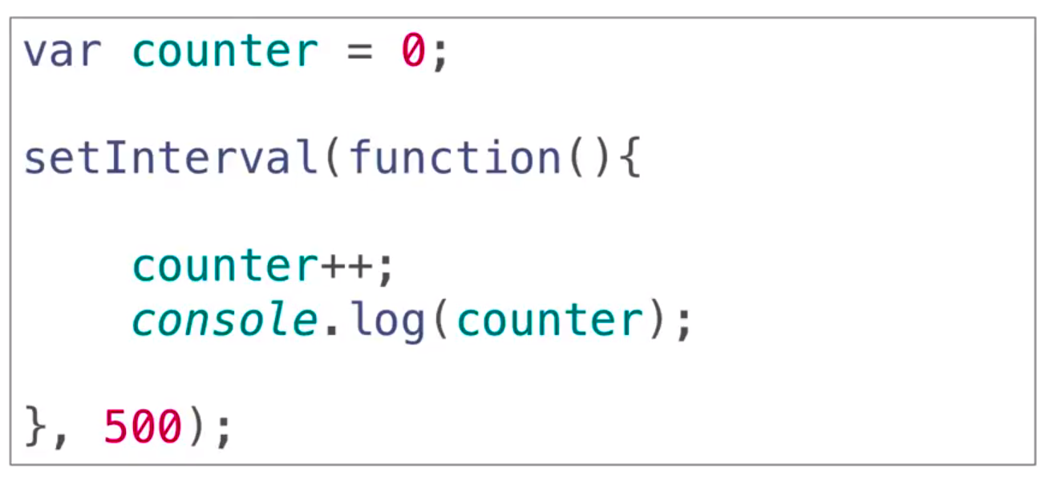
Timers
milliseconds
You can watch the timer counting in the console
Notes:
var counter = 0;
setInterval(function(){
counter++;
console.log(counter);
}, 500);

Slide 24
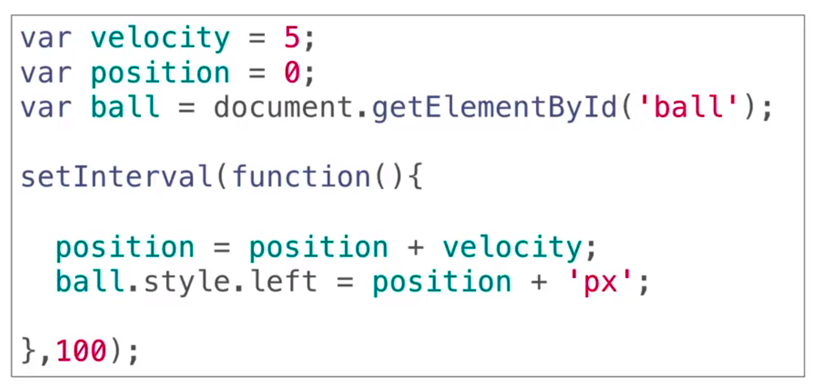
Moving in Time/Space – Move ball using timer
Notes:
var velocity = 5;
var position = 0;
var ball = document.getElementbyId('ball');
setInterval(function(){
position=position + velocity;
ball.style.left=position + 'px';
}, 100);

Slide 25
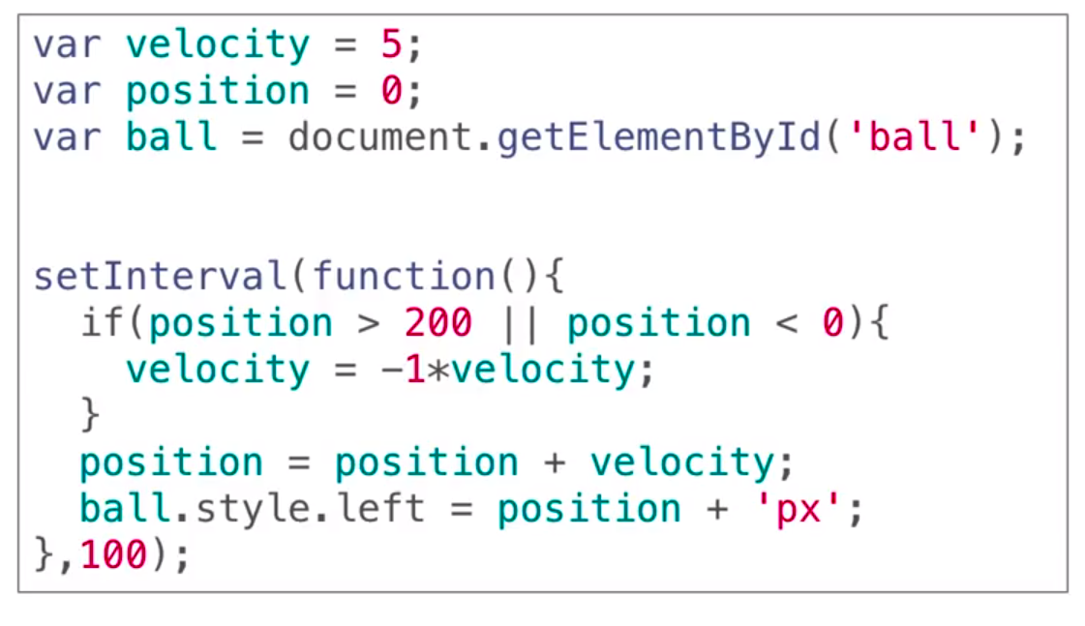
Edge Detection

Slide 26
Challenges/Bonus
Change speed on bounce
Change color on bounce
Change color depending on x/y direction
Change size on bounce
Add more balls

Slide 27

Project Time!

